Slide 1
Using the movement of centroid to measure the inferior – superior translation of tibia relative to the femur under different conditions

Slide 2
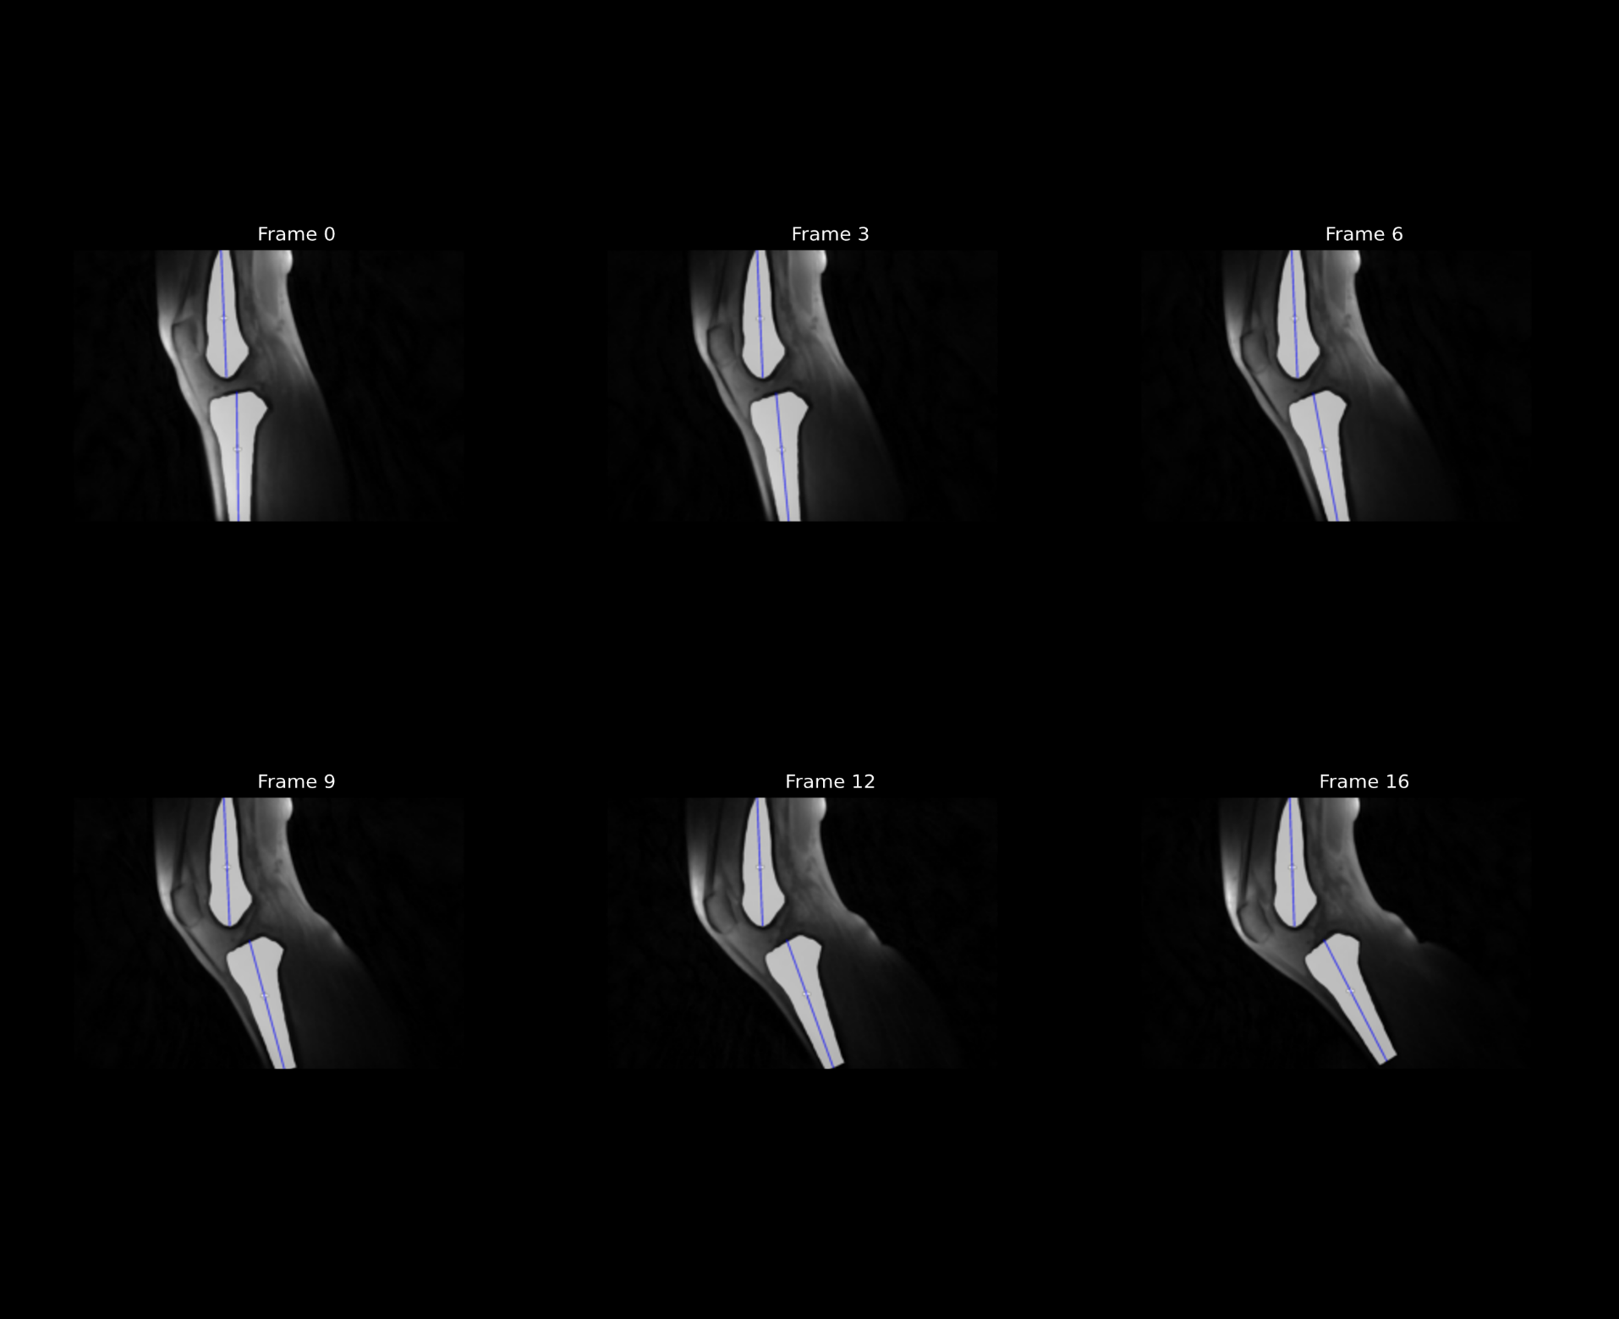
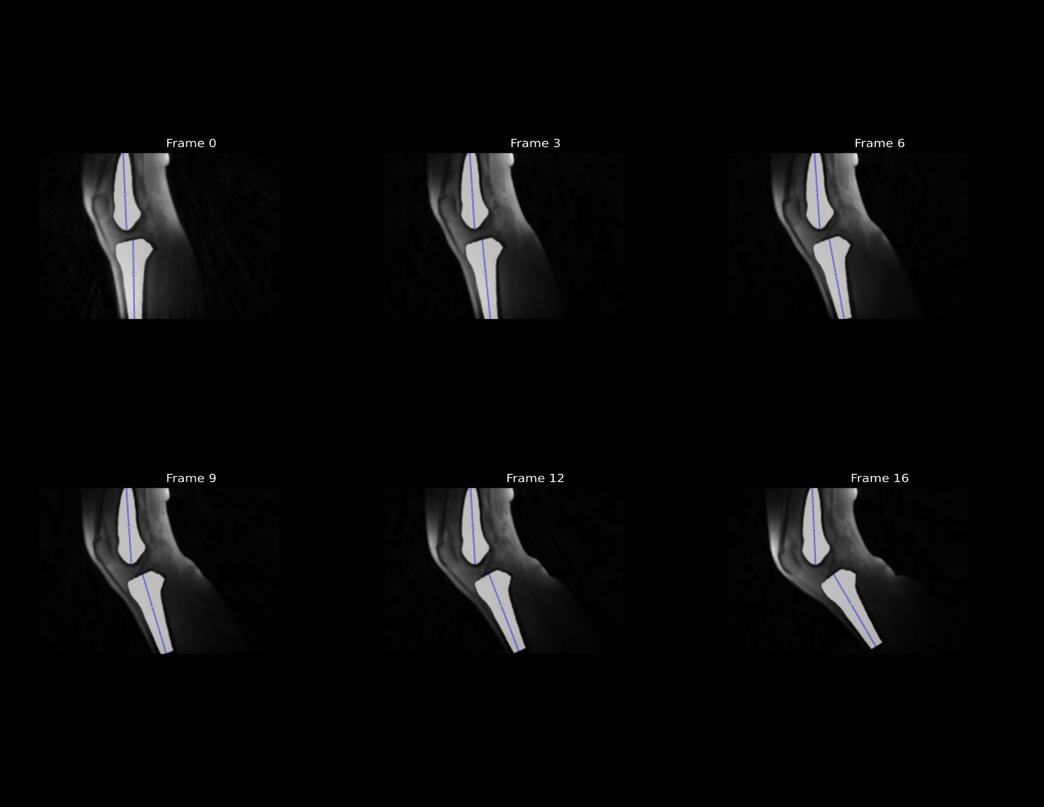
Subject 1
Unloaded
Loaded

Slide 3
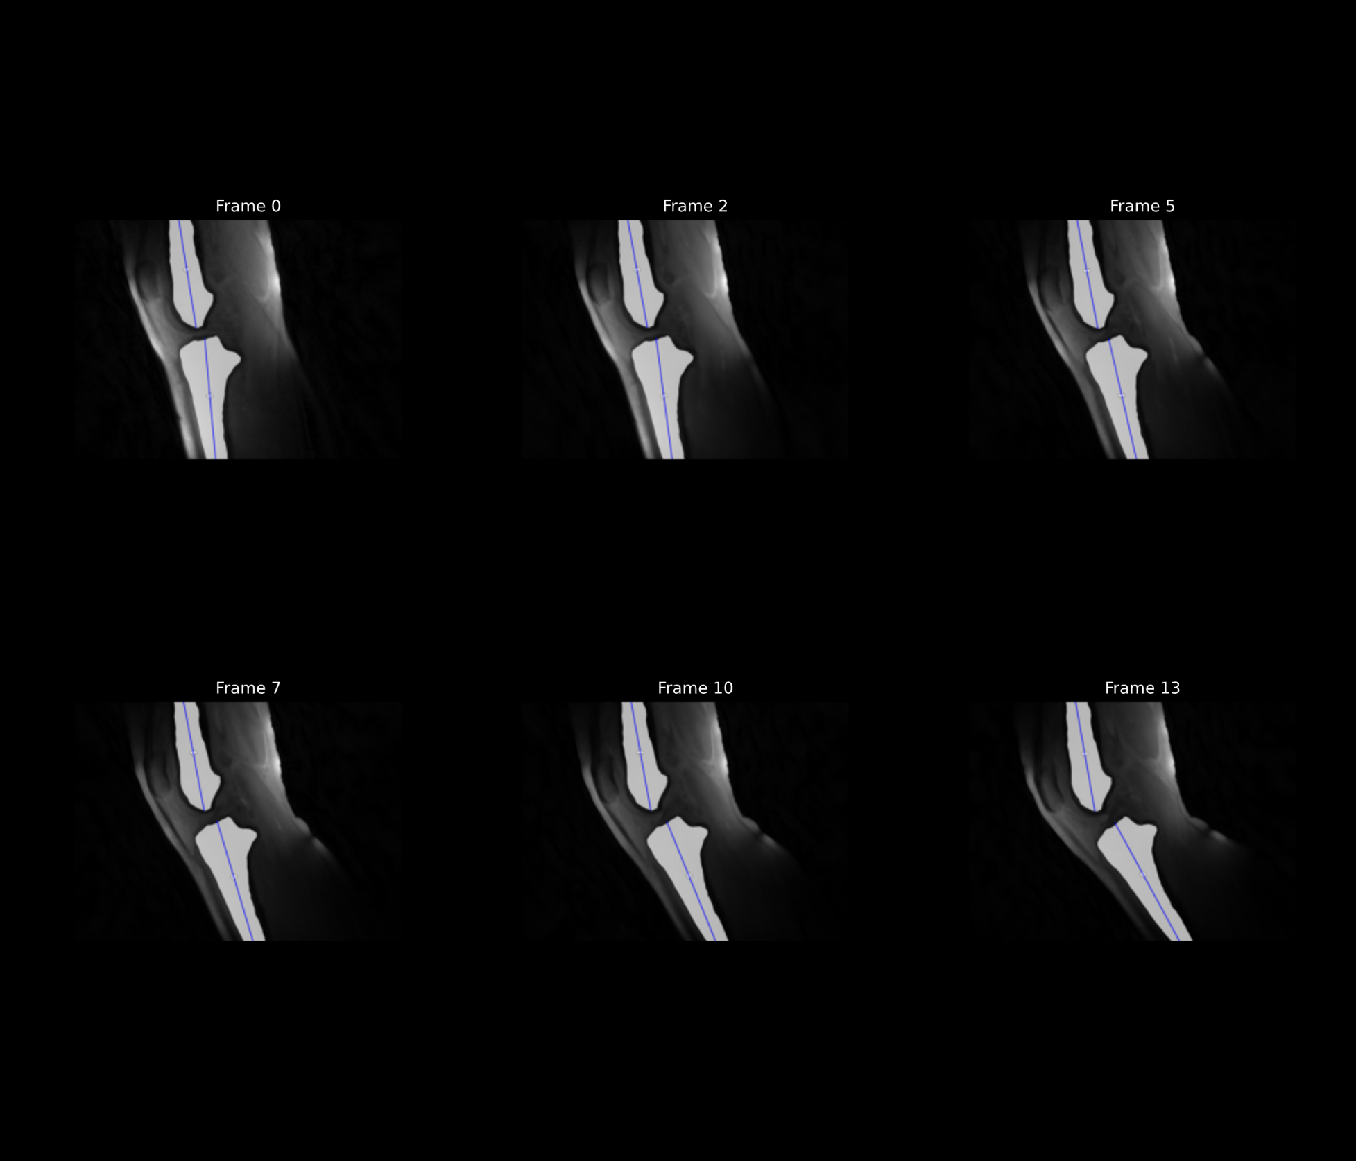
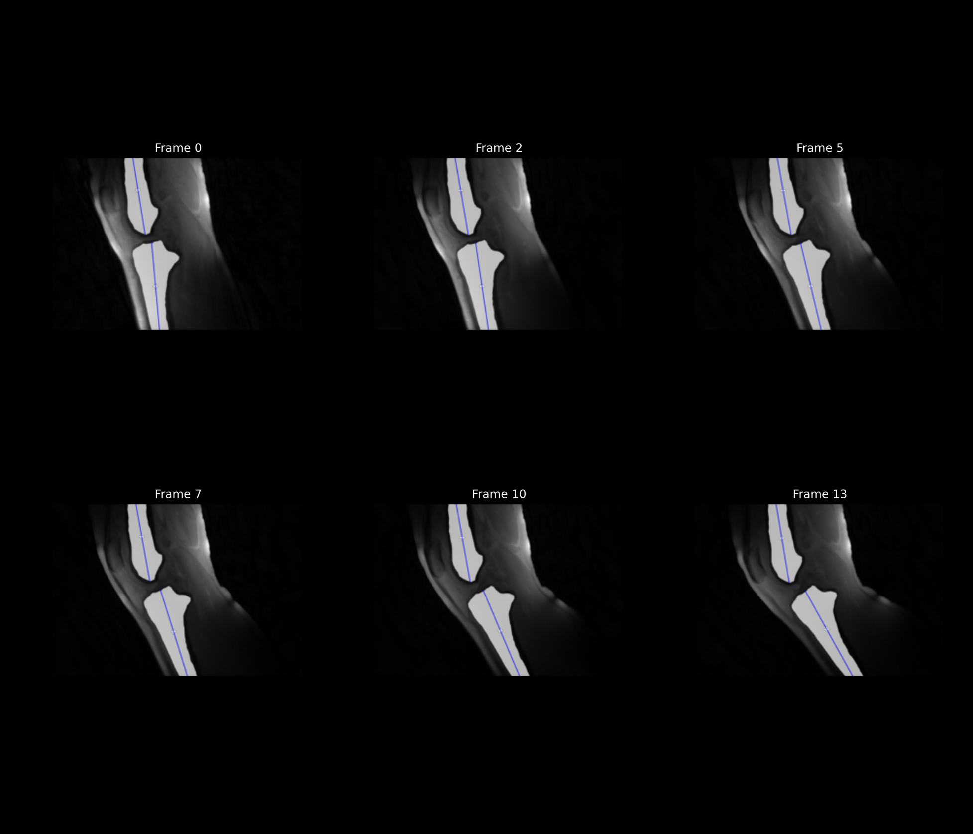
Subject 2
Unloaded
Loaded

Slide 4
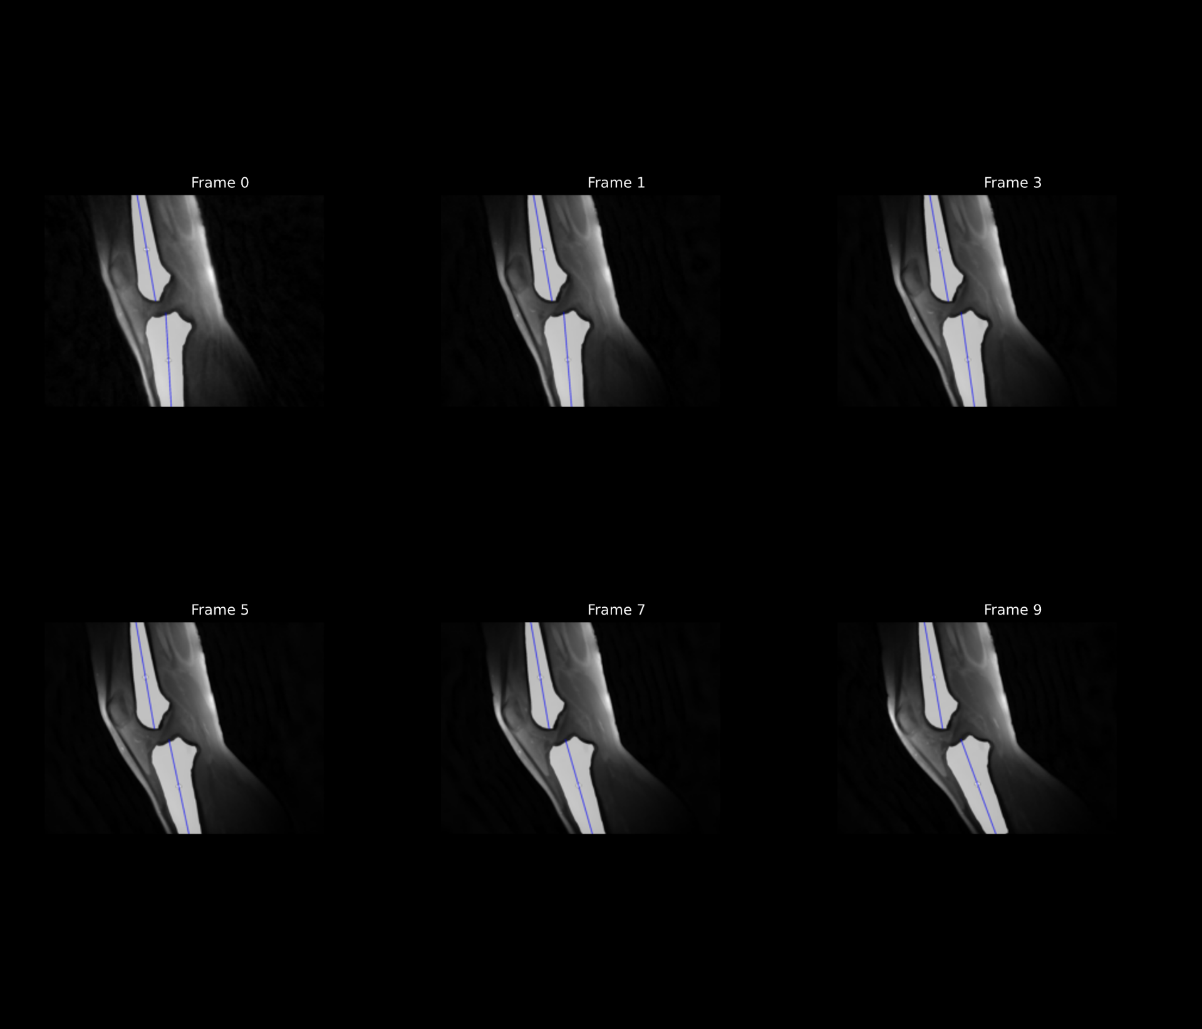
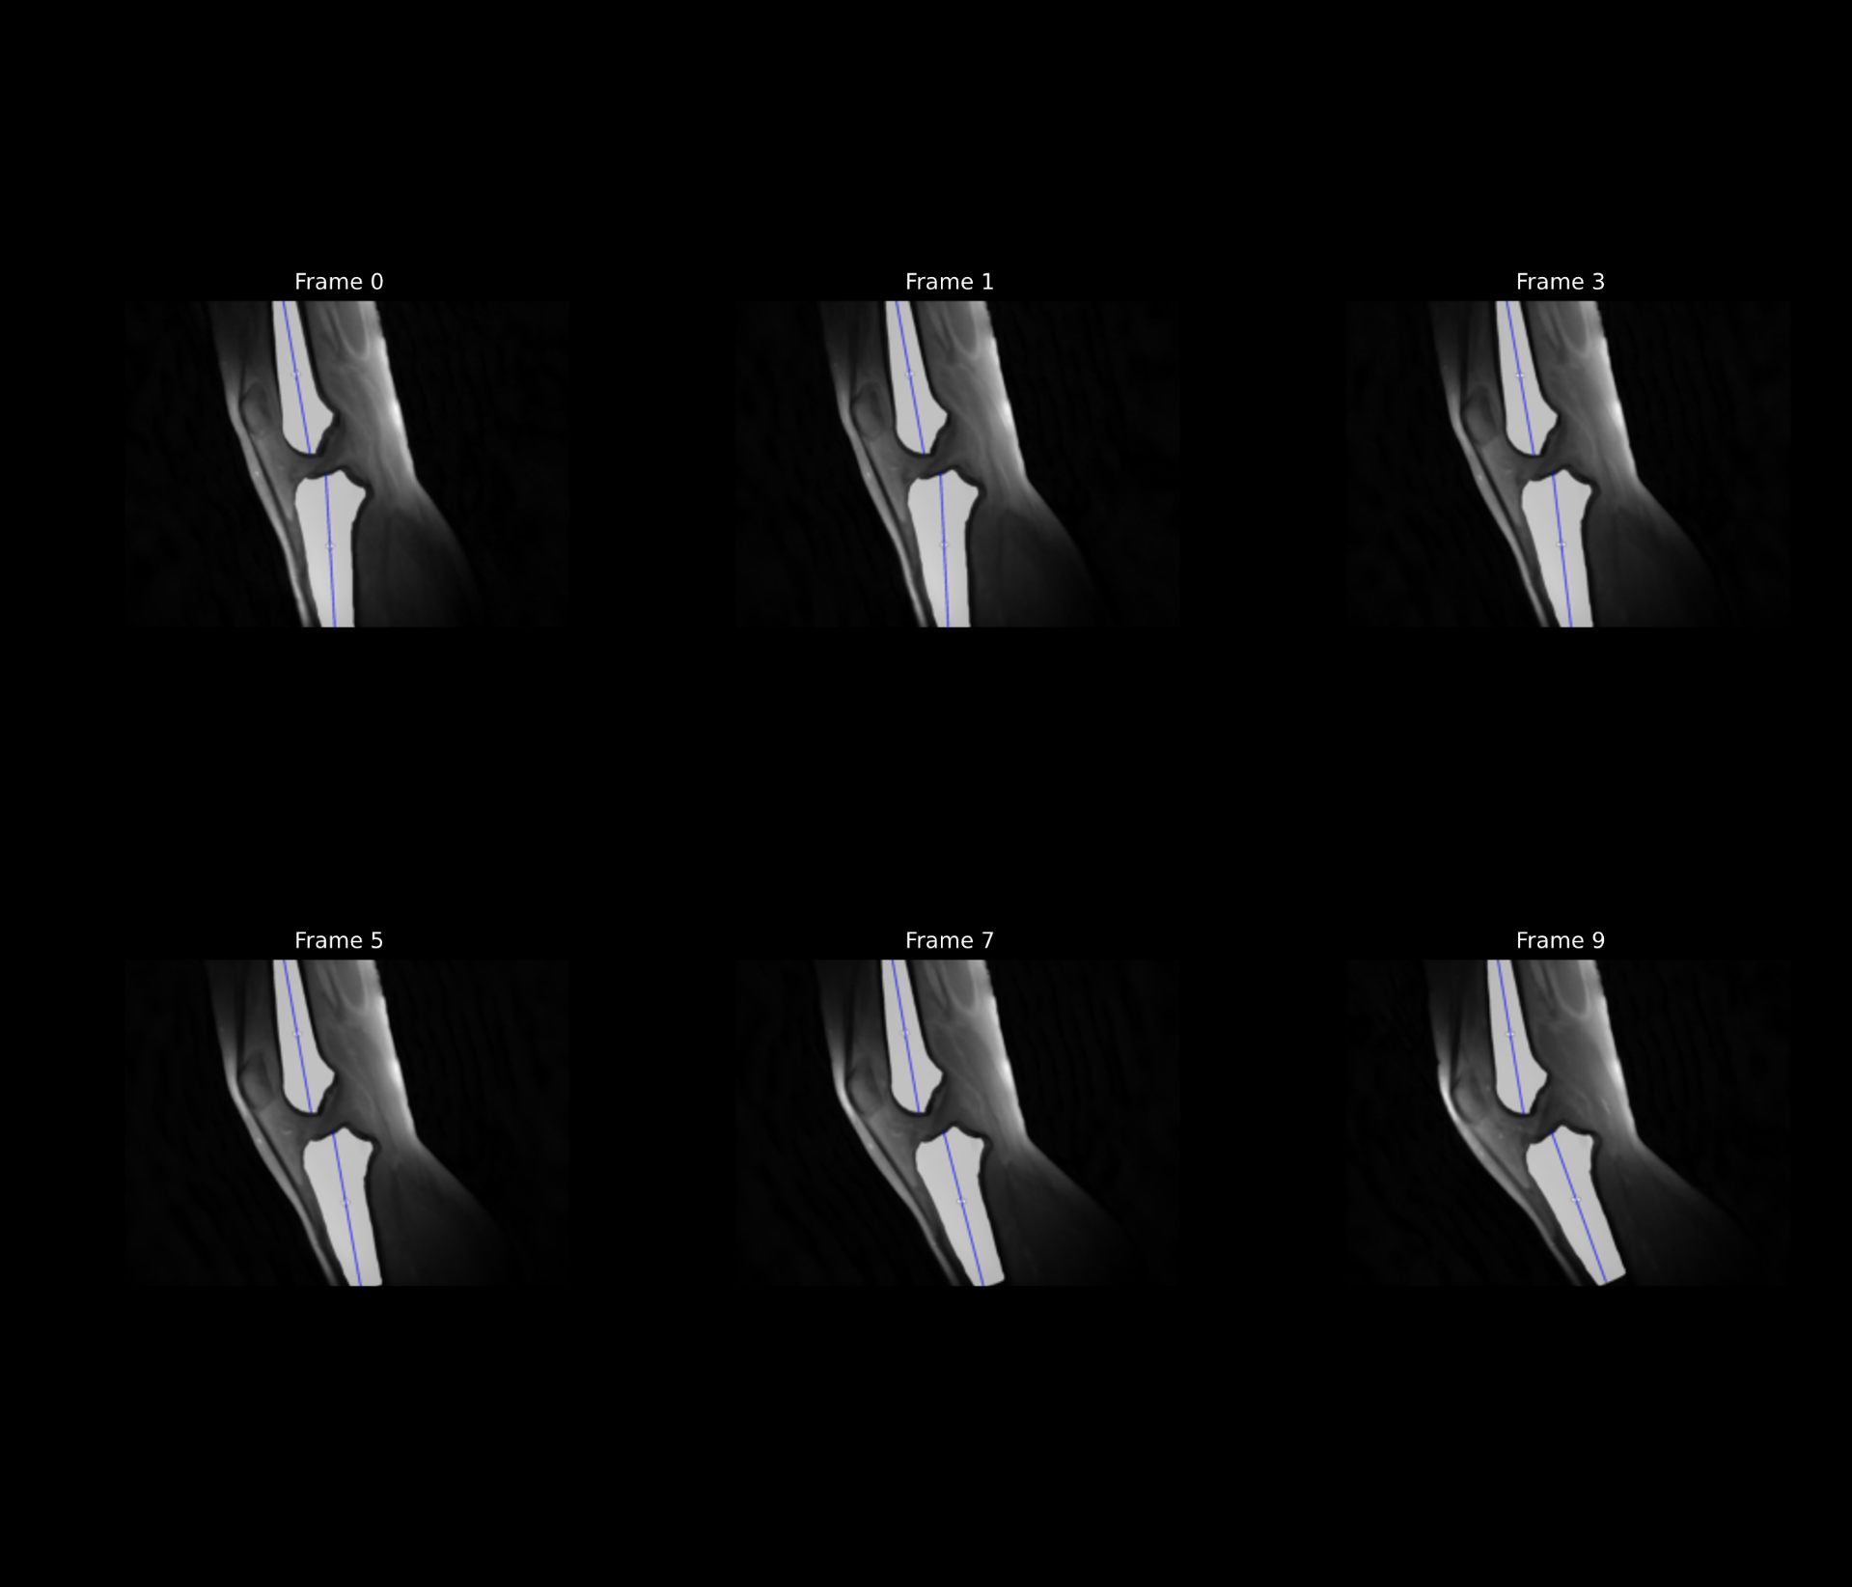
Subject 3
Unloaded
Loaded

Slide 5
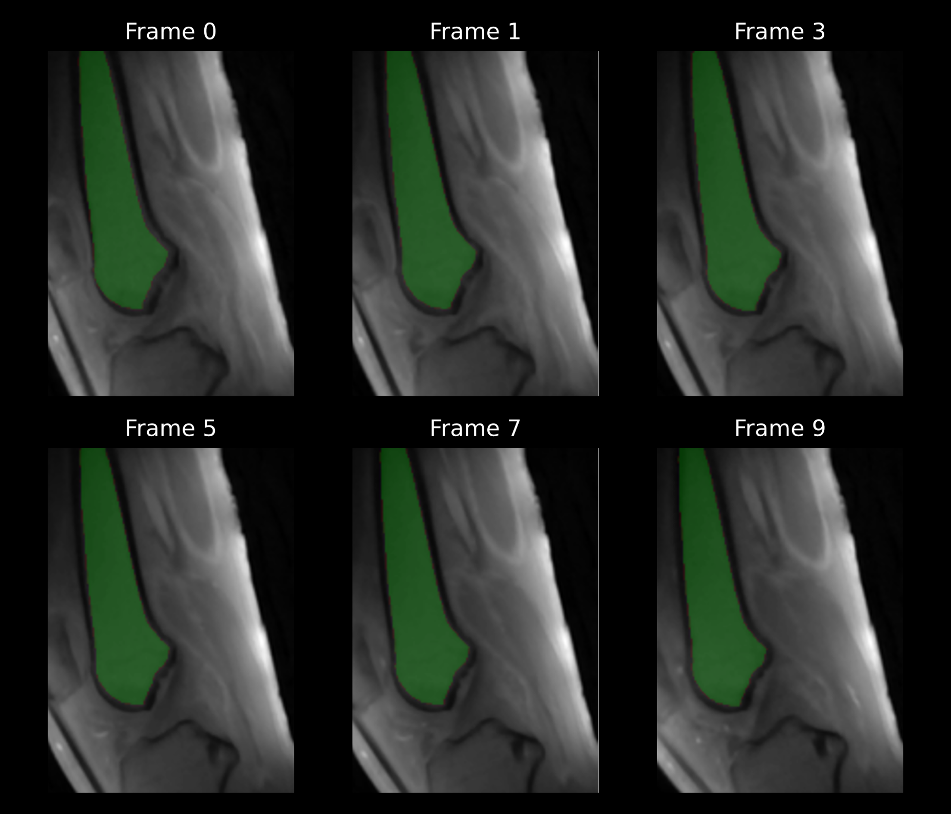
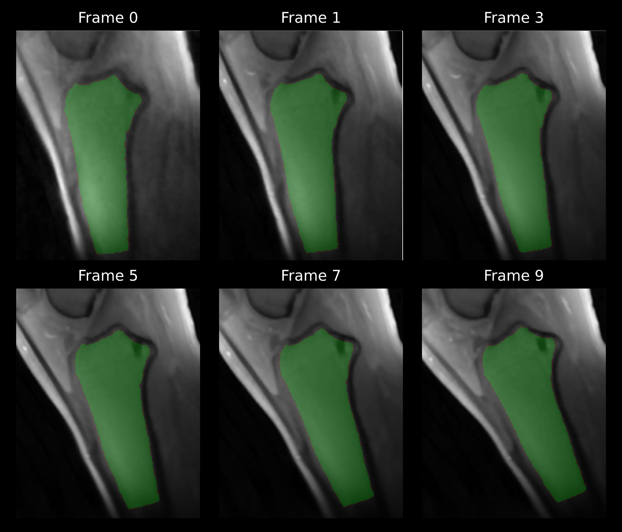

Slide 6
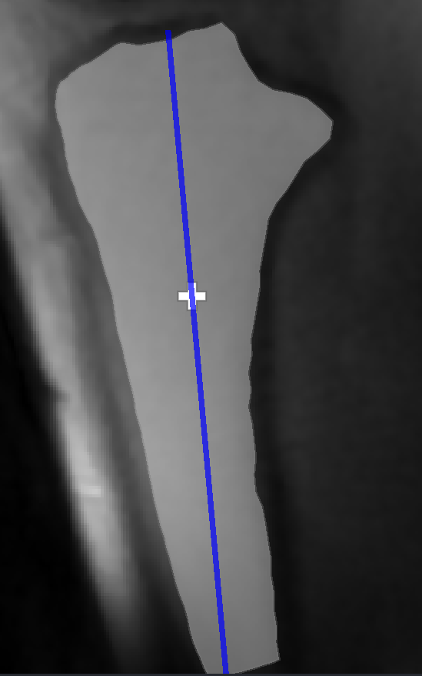
Closeup view

Slide 7
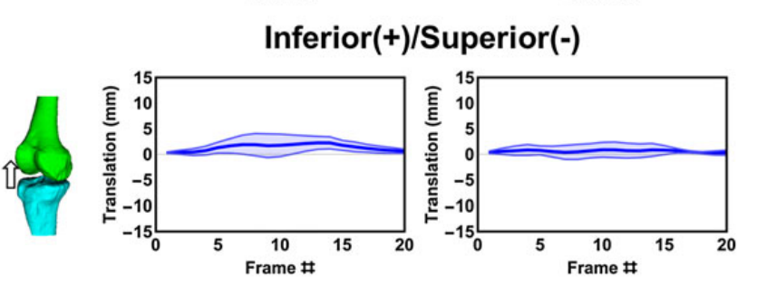
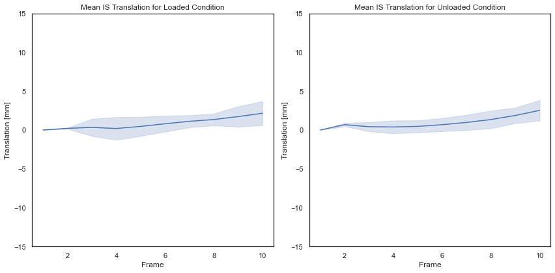
Comparision with the Mazzoli et al (2017) paper
Range of motion: 16.2° ± 1.7°
Range of motion: 20°
#Subjects: 5
Full Cycle

Slide 8
